Slide 1
CSS3
<!DOCTYPE html>
<html>
<head>
<style>
#fact {
background-color: white;
padding: 1em;
border-radius: 15px;
}
</style>
</head>
<body>
<h1>My CSS web page!</h1>
<span id=“fact”>Chuck Norris can make a vegetarian ham sandwich.</span>
</body>
</html>
Claudio Pimpao

Slide 2
Cascading Style Sheets
Used:
Within the HTML markup (<style type="text/css">…</style>)
Link to CSS file (<link type="text/css" href=“style.css" rel="stylesheet">)
Into the DOM: (<div style=“…”></div>)
Attributes: media, scoped (link, HTML5, Boolean, only for parent element and child elements, not supported yet) and type
Style sheet → rules/rule-set → selector(s) + declaration block.
Selectors: tag, id, class, relative position, pseudo-class (:link, :hover), pseudo-element (address sub-parts of elements, :first-letter, :before)
<section>
<style scoped>
p { color: red; }
</style>
<h2>How does it work?</h2>
</section>
<link rel="stylesheet" media=“tv" href="small.css" />

Slide 3
Cascading Style Sheets
[From W3C] Priorities/weights are calculated and assigned to rules (! Media !):
user agent declarations
user normal declarations
author normal declarations
author important declarations
user important declarations
If equal: specificity of selector: more specific selectors will override more general ones
Finally, the latter specified wins.
Notes:
http://www.w3.org/TR/CSS2/cascade.html#specificity

Slide 4
Cascading Style Sheets
li {} /* a=0 b=0 c=0 d=1 -> specificity = 0,0,0,1 */
li:first-line {} /* a=0 b=0 c=0 d=2 -> specificity = 0,0,0,2 */
ul li {} /* a=0 b=0 c=0 d=2 -> specificity = 0,0,0,2 */
ul ol+li {} /* a=0 b=0 c=0 d=3 -> specificity = 0,0,0,3 */
ul ol li.red {} /* a=0 b=0 c=1 d=3 -> specificity = 0,0,1,3 */
li.red.level {} /* a=0 b=0 c=2 d=1 -> specificity = 0,0,2,1 */
#x34y {} /* a=0 b=1 c=0 d=0 -> specificity = 0,1,0,0 */
style="" /* a=1 b=0 c=0 d=0 -> specificity = 1,0,0,0 */
Notes:
http://www.w3.org/TR/CSS2/cascade.html#specificity
Concatenating the four numbers a-b-c-d (in a number system with a large base) gives the specificity.
A: count 1 if the declaration is from is a 'style' attribute rather than a rule with a selector, 0 otherwise (= a) (In HTML, values of an element's "style" attribute are style sheet rules. These rules have no selectors, so a=1, b=0, c=0, and d=0.)
B: count the number of ID attributes in the selector (= b)
C: count the number of other attributes and pseudo-classes in the selector (= c)
D: count the number of element names and pseudo-elements in the selector (= d)

Slide 5


Versions
Håkon Wium Lie
CSS Working Group
Versions (Candidate Recommendations)
CSS1 (1996), CSS2 (1998), CSS2.1 (2010)
CSS3 → split into modules
CSS4
Ab­bre­vi­a­tion | Full name
WD | Working Draft
LC | Last Call
CR | Candidate Recommendation
PR | Proposed Recommendation
REC | Recommendation
Notes:
2005 change process to write recommandations

Slide 6
CSS3-4
Rule n°1: CSS3 is completely backwards compatible
CSS3 Modules: Add new capabilities or extends features defined in CSS2:
Over fifty CSS modules published
Actual work: http://www.w3.org/Style/CSS/current-work
Example: Media Queries http://www.w3.org/TR/css3-mediaqueries/
Others: Selectors, Box Model, Backgrounds and Borders, Text Effects, 2D/3D Transformations, Animations, Multiple Column Layout
CSS4: New modules build on the functionality of preceding level 3 modules or entirely new functionalities. (Flexbox, Image Values, etc.)
Notes:
http://www.w3schools.com/css3/css3_intro.asp
CSS3 start: first drafts were published in June 1999

Slide 7
2D/3D transformations Transitions
Notes:
Working drafts

Slide 8

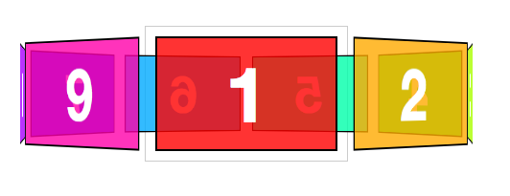
2D/3D transformations
Possibilities:
2d: matrix, translate, translateX, translateY, scale, scaleX, scaleY, rotate, skew, skewX, skewY
3d: scale3d, matrix3d, translate3d, rotate3d, …
div { transform: rotate(30deg); -ms-transform: rotate(30deg); /* IE 9 */ -webkit-transform: rotate(30deg); }
div {
transform: matrix3d( 1, 0, 0, 0,
0, 1, 0, 0,
0, 0, 1, 0,
0, 0, 200, 1);
}
Notes:
http://media02.hongkiat.com/css3-2d-transformation/demo/index.html

Slide 9
Combined to transitions
div { transition: width 2s, height 2s, transform 2s; -webkit-transition: width 2s, height 2s, -webkit-transform 2s; }
http://tympanus.net/Tutorials/CreativeCSS3AnimationMenus/index3.html
http://desandro.github.io/3dtransforms/examples/card-01.html

Slide 10
Last module: Media queries → Adaptive/Responsive Design

Slide 11
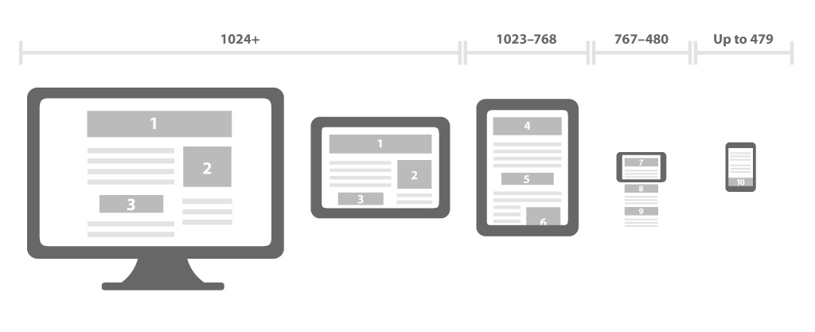



Adaptive/Responsive Web Design
Notes:
http://www.w3.org/TR/2010/CR-css3-mediaqueries-20100727/

Slide 12
Adaptive/Responsive Web Design
Responsive
Adaptive
Notes:
http://futureinsightslive.com/las-vegas-2013/
http://andrewlohman.com/
Adaptive: http://yokedesign.com.au/services/

Slide 13
Adaptive/Responsive Web Design
Adaptive
Responsive
Notes:
http://www.w3schools.com/css3/css3_transitions.asp

Slide 14
A/RWD - Principles
Mobile First (new developments)
Try to keep JavaScript unobtrusive
Progressive enhancement no graceful degradation
All content must be displayed on all devices. Yep, we will try ☺

Slide 15
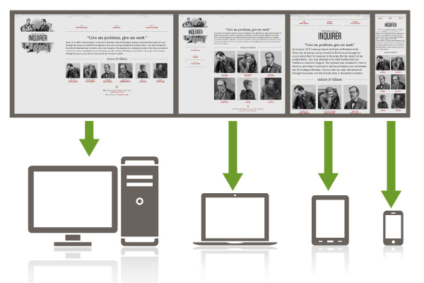

A/RWD - Principles
Fluid (proportion-based) grids
Relative units percentages or EMs
Flexible images max-width: 100%;, media query, Responsive Images (W3C/WHATWG)

Slide 16
<picture>
<source media="(min-width: 45em)" srcset="large-1.jpg 1x, large-2.jpg 2x">
<source media="(min-width: 18em)" srcset="med-1.jpg 1x, med-2.jpg 2x">
<source srcset="small-1.jpg 1x, small-2.jpg 2x">
<img src="small-1.jpg" alt="my alt-text" width="200" height="100">
</picture>

Slide 17
Mobile solutions
 | Native Application | Hybrid application | Responsive Design
Dev costs | ● | ● | ●
UX/User interaction | ● | ● | ●
Device access | ● | ● | ●
Maintenance | ● | ● | ●
Store disponibility | ● | ● | ●
Needed skills | ● | ● | ●

Slide 18
Media Queries
<link rel="stylesheet" type="text/css" media="print" href="serif.css">
@import url(color.css) screen and (color);
@media screen and (min-width: 400px) and (max-width: 700px) {…}
Medias types: all, aural, braille, handheld, print, projection, screen, tty, tv, speech
Media capabilities: width, height, device-width, device-height, orientation, aspect-ratio, device-aspect-ratio, color, color-index, monochrome, resolution, scan, grid
<meta name="viewport" content="width=device-width, initial-scale=1.0, user-scalable=yes">
Compatibility: http://caniuse.com/#feat=css-mediaqueries
Notes:
http://www.w3.org/TR/css3-mediaqueries/
We need to stop for a minute and discuss media="handheld". Fact is, Android and iOS ignore media="handheld". The claim is that users will miss the high end content provided by stylesheets targeting media="screen" and developers are less likely to maintain a lower quality media="handheld" version. So, as part of their "full web" motto, most modern smart phone browsers simply ignore handheld style sheets.

Slide 19
Let’s try

Slide 20
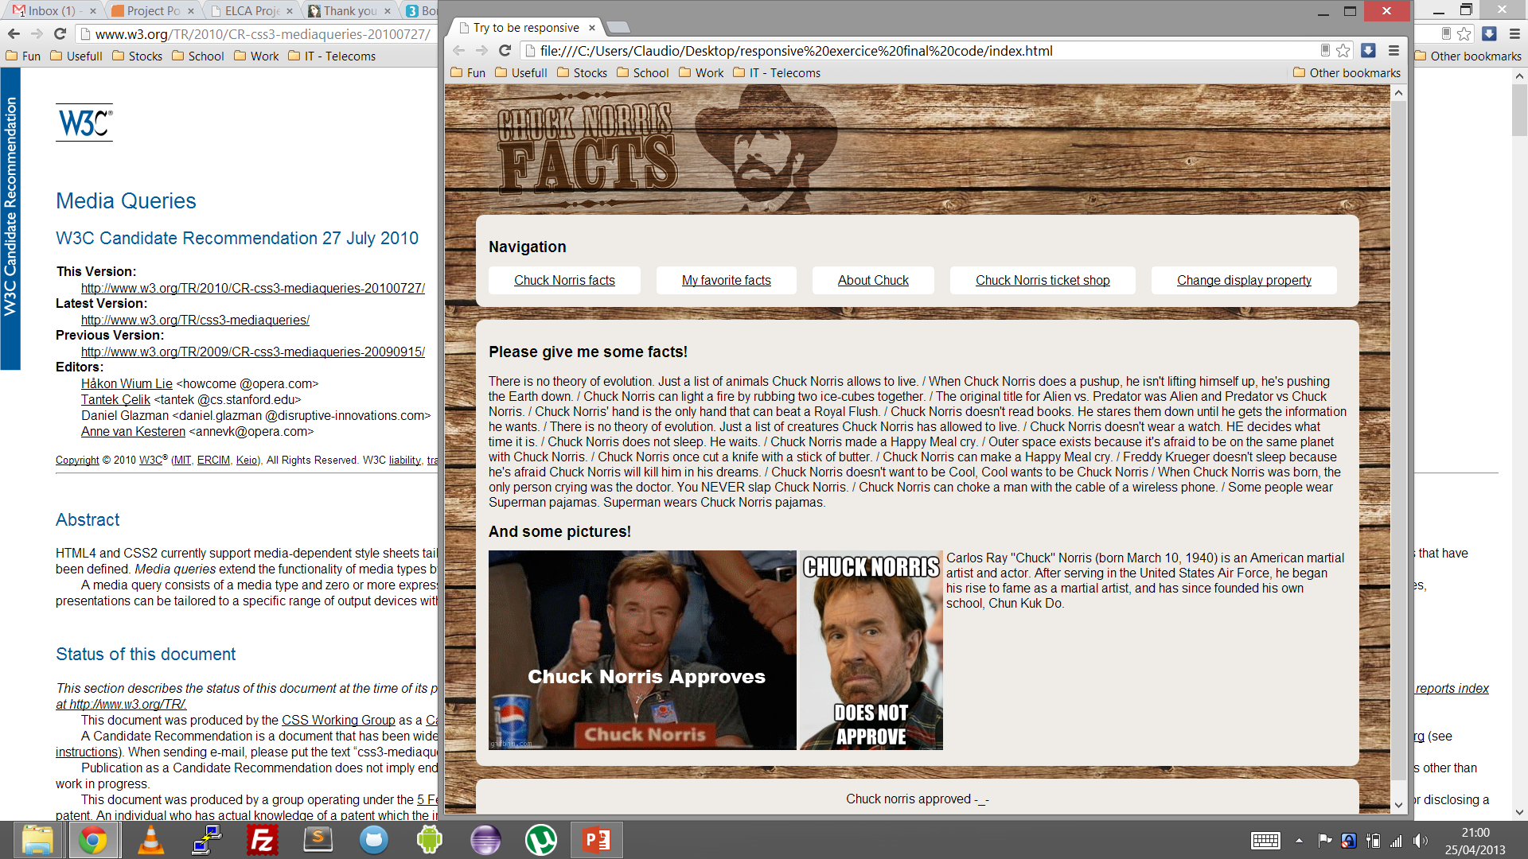
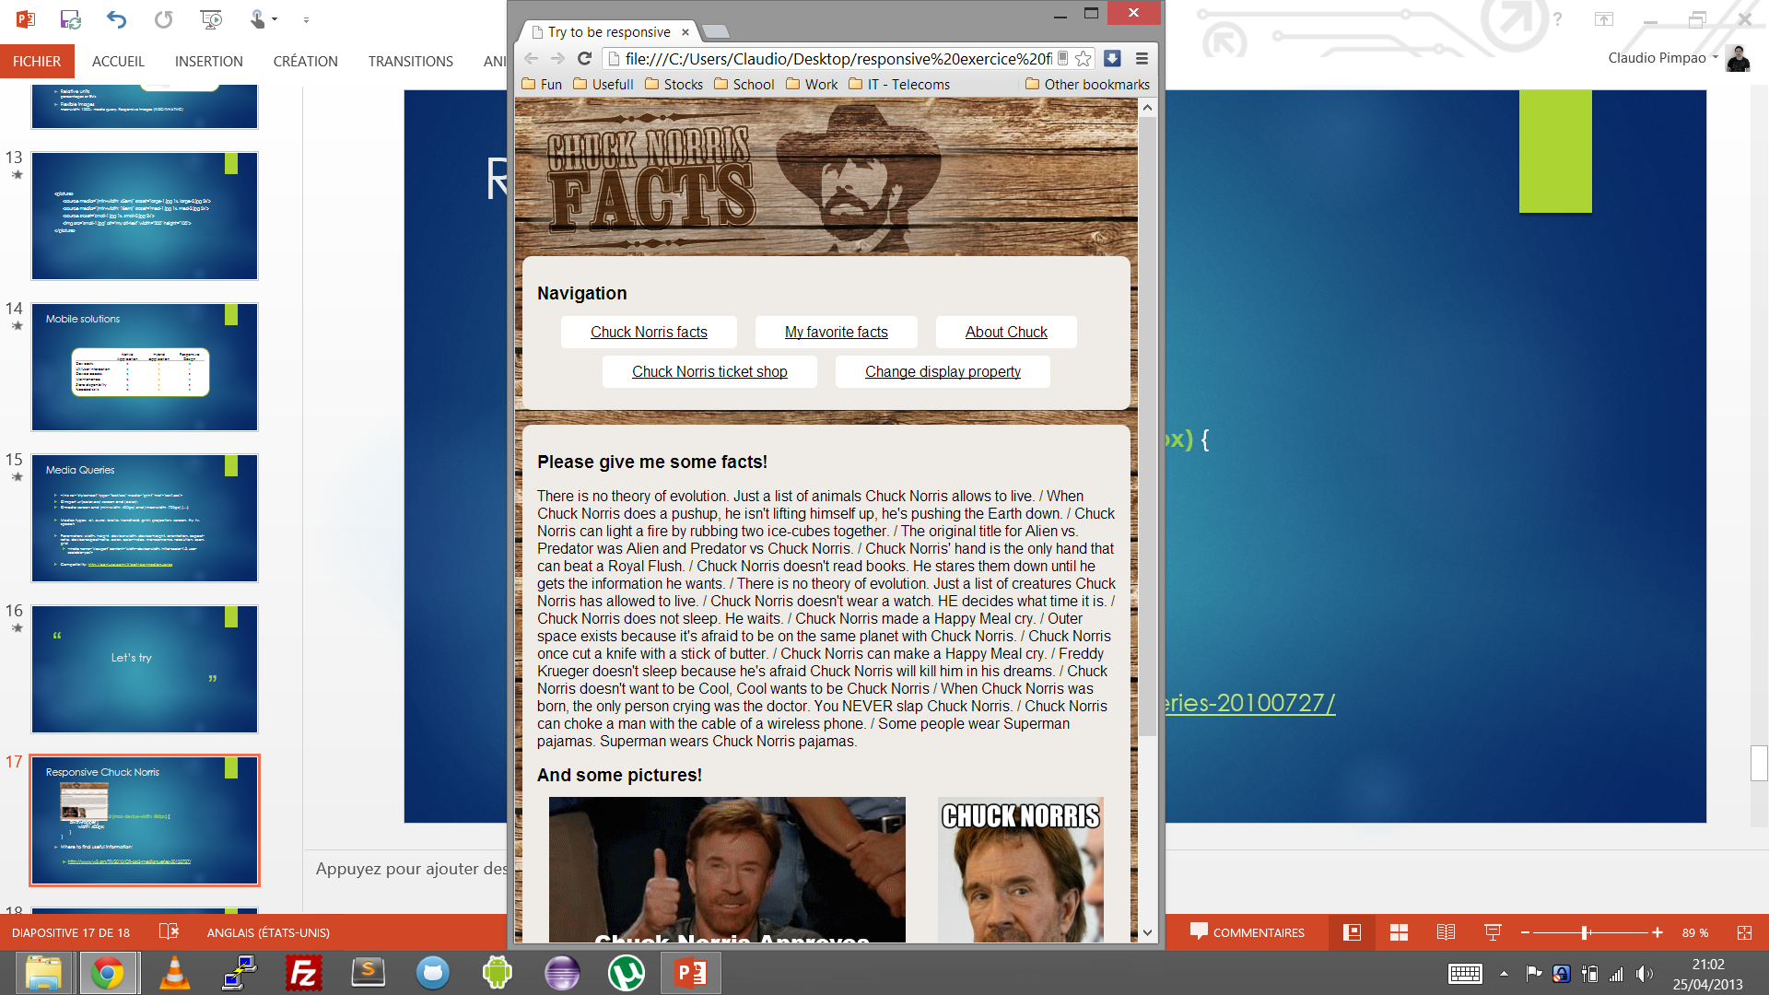
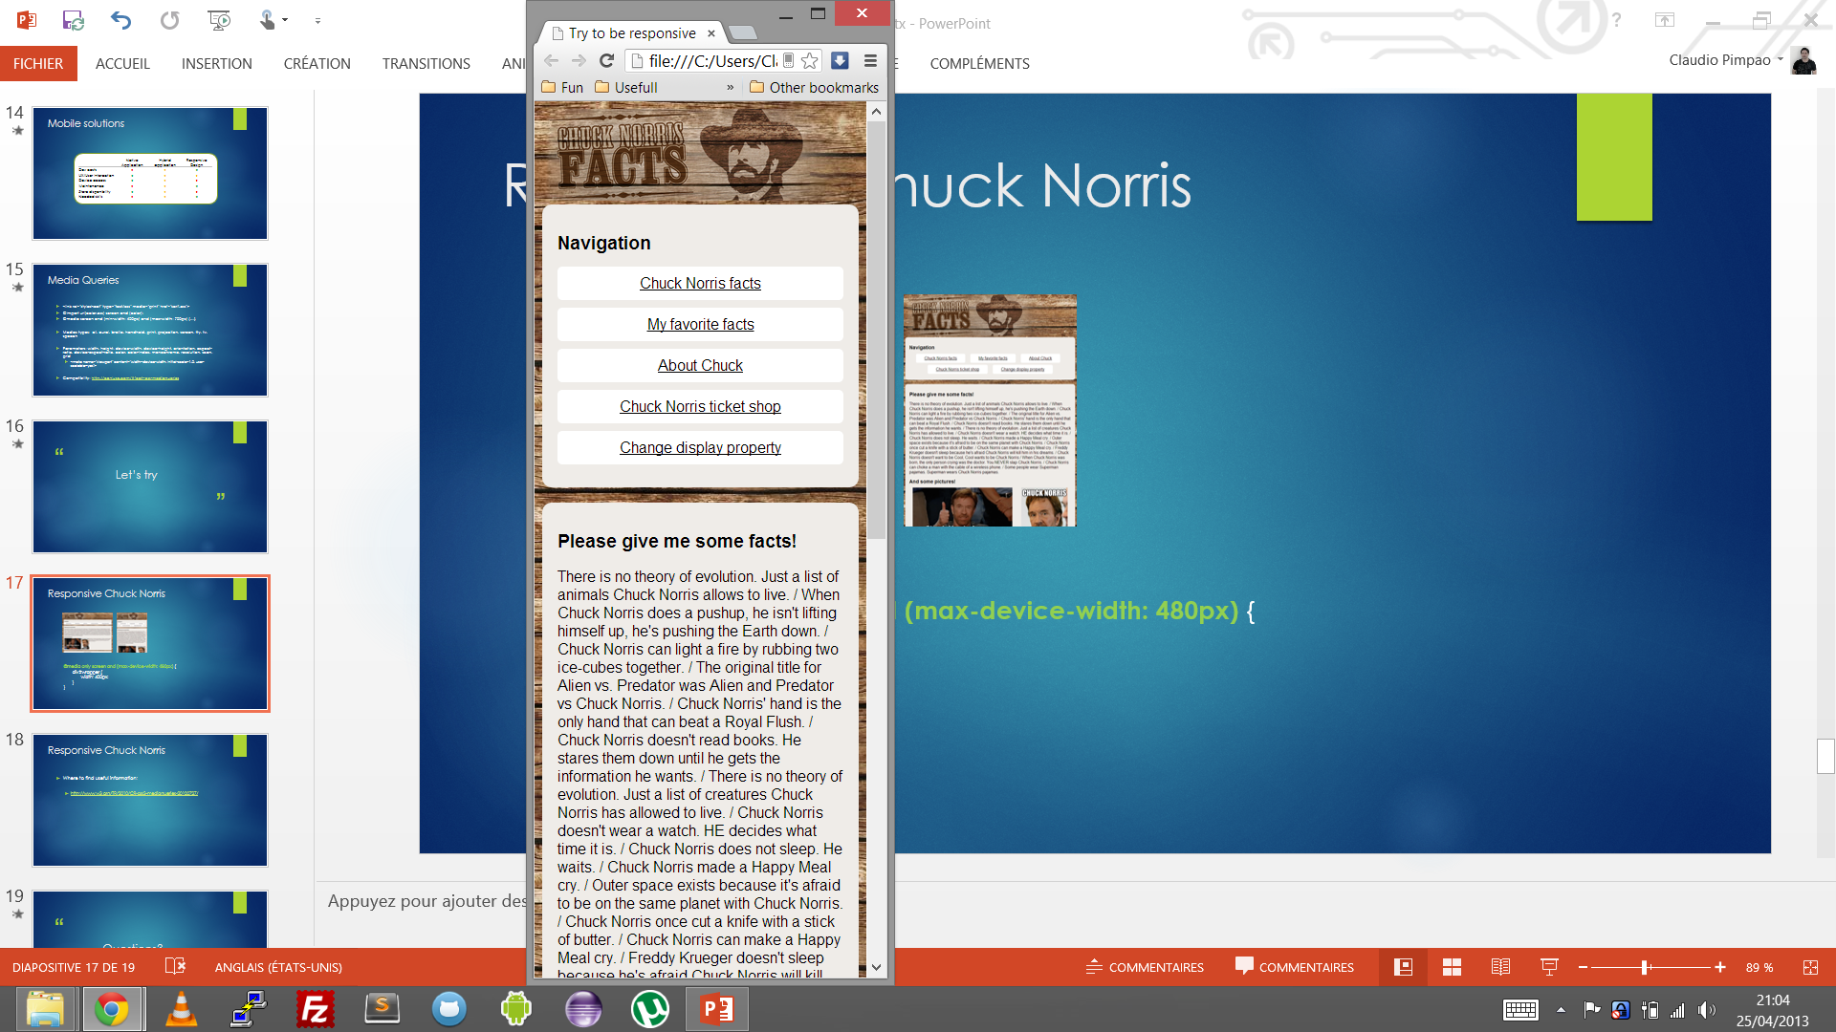
Responsive Chuck Norris
@media only screen and (max-width: 480px) {
div#wrapper {
width: 400px;
}
}

Slide 21
Responsive Chuck Norris
Where to find useful information:
http://mobile.smashingmagazine.com/2010/07/19/how-to-use-css3-media-queries-to-create-a-mobile-version-of-your-website/
http://www.w3.org/TR/css3-mediaqueries/
https://developer.mozilla.org/en/docs/CSS/Media_queries
http://www.w3schools.com/css/css_mediatypes.asp

Slide 22
Questions?
Notes:
http://www.w3schools.com/css3/css3_animations.asp

